Slide 1
A Review and Analysis of Eye-Gaze Estimation
Paper Summary

Slide 2
Paper Structure
Gaze Tracking Fundamentals
Gaze Estimation Algorithms
User Platforms Implementing Gaze Tracking
Performance Metrics and Platform-Specific Error Sources
Performance Evaluation Framework

Slide 3
Gaze Tracking Fundamentals
Fixations: Eyes stationary. Visual input
Saccades: Rapid, involuntary. Between Fixations
Scan-Path: Fixations + Saccades until eye reaches target
Gaze Duration
Pupil Size

Slide 4
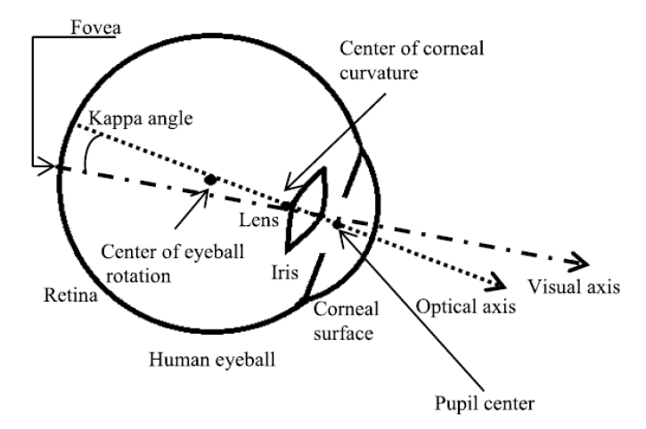
Typical Eye Model
Visual Axis
Fovea to corneal curvature
Defines gaze
Cannot be measured ☹
Optical Axis
Pupil center to corneal curvature
Can be measured
Kappa Angle
Unique
Can be obtained through calibration
Optical Axis + Kappa = Visual Axis ☺

Slide 5
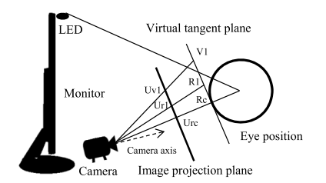
Active Estimation Methods
Use NIR LED Induced Glint
2D Regression Based:
Done by mapping Pupil Center → Corneal Glint vector
Cross Ratio Based:
Rectangular pattern projection for head pose estimation
3D Model Based*:
Use a geometrical eye model to estimate center of cornea, optical and visual axis
Notes:
*There is a 3D model based method using a Kinect, which makes that method passive
PCCR – Pupil Center Corneal Reflection

Slide 6
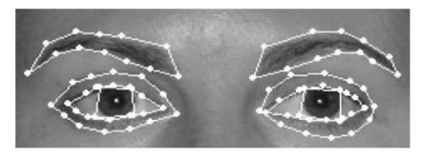
Passive Estimation Methods - Appearance Based
Use shape and texture
Eye contour
Iris size, location
Positions of pupils
Estimation through best fit
Low HW req.

Slide 7
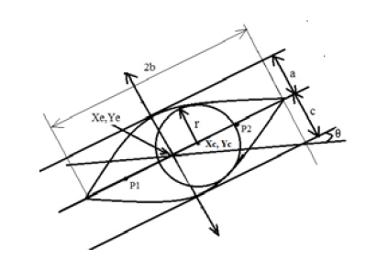
Passive Estimation Methods - Shape Based
Fits parabolas, circle to eye contour, iris
Vulnerable to:
Head movement
Eye occlusion

Slide 8
Passive Estimation Methods – 3D Model Based
Three works use a depth camera (Kinect)
Kinect used to obtain head pose, iris and eyeball centers
Calibration used to obtain 3D coordinates of eye parameters
Allows head movement
Notes:
Depth:
[62] -K. Wang and Q. Ji, ``Real time eye gaze tracking with Kinect”
[63]- X. Zhou, H. Cai, Z. Shao, H. Yu, and H. Liu, ``3D eye model-based
gaze estimation from a depth sensor”
[64] - L. Jianfeng and L. Shigang, ``Eye-model-based gaze estimation by
RGB-D camera”

Slide 9
Algorithms Summary – Pros & Cons
Method | Pros | Cons
2D Regression | Utilizes Features of human eye Easy to implement | Not robust to movements
3D Model | Robust to movements | Hard and Expensive implementation
Cross Ratio | Do Not rely on 3D Do not require Calibration Robust to movements | Very dependent of user distance and environmental factors
Appearance Based | Relatively Cheap implementation | Not accurate as PCCR methods Requires large DB of tagged data (For NN training) Not robust to movements or illumination
Shape Based | Relatively Cheap implementation Sufficient accuracy | Not robust to movements or occlusions High computational complexity (Similarity calculations) Model initialization issues

Slide 10
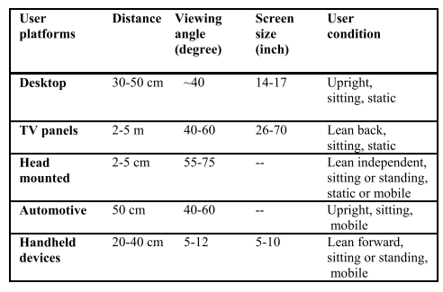
User Platforms Implementing Gaze Tracking
The paper presents 5 main user platforms:
Desktop Based
TV and Large Display Panels
Head-Mounted Setups (VR, AR, etc.)
Automotive
Hand-Held (Smartphones, Tablets, etc.)
Unique conditions, accuracy and best algorithm
Typical Accuracy:
Head-Mounted – less than 1 degree
Desktop – 0.5-2 degrees
Automotive and Hand-Held (Dynamic Platforms) - >2 degrees
The same tracker may supply different results for different platforms
Notes:
Table – Different user poses and conditions in different platforms

Slide 11
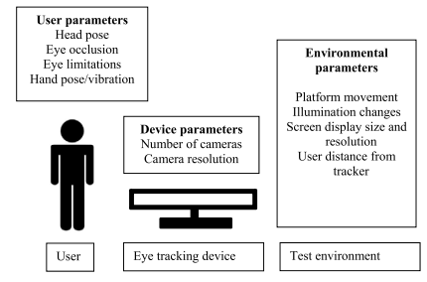
Performance Metrics and Platform-Specific Error Sources
Works in gaze estimation evaluate their results in any of:
Angular resolution [deg.]
Gaze recognition rate [%]
Shift from ground truth [pix.] , [cm.]
Operating conditions rarely taken into consideration or characterized
Therefore most gaze estimation methods cannot be inter compared
Currently - no comprehensive practice for performance evaluation

Slide 12
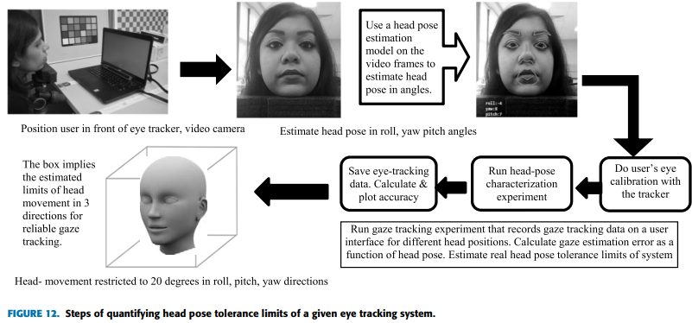
Suggested Performance Evaluation Framework
To understand the effects of different factors, a methodology composed of the following experiments, with a set of realistic test values, is proposed
Head pose impact (roll, pitch & yaw)
Various illumination (color temperature and intensities)
User distance and viewing angle
Display size and resolution
Occlusions (e.g. glasses)
Platform movement
Work still in progress

Slide 13
What’s next?
Given an RGB-D camera, which method would be the best?
What are the Realsense’ capabilities? Can it be used to estimate the user’s different characteristics (cornea curvature, head pose)?
Should we consider/use the suggested Performance Evaluation Framework?
If 3D Model method is the way, on which model should we focus? Do we have enough data?
How can a NN classify to almost continuous output?

